Slide 1
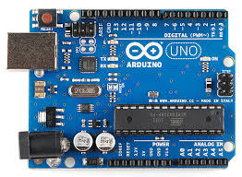

HEALTHCARE MONITORING SYSTEM WITH COGNITIVE IOT & WBAN
N.G.KARTHI M.DILLI BABU
S.MAHESH (Assistant Professor)
C.R.MANIKANDARAJ
P.SATHYARAJ

Slide 2
Abstract
This project is based on Wireless Body Area Network (WBAN).
In this health care monitoring system they measure some of the vital parameter of the human body (blood pressure , temperature , ECG , etc..,)
The data which are measured from human body are transfer via wireless sensor to the android smart phone for further analysis.
We use BLUETOOTH sensor for transmission physiological data.
Every patient details are stored in the database for future reference .
If any changes occurs in the physiological parameter alert message will be sent to the doctor immediately along patient current location.
The stored data will be represented in the graphical format.

Slide 3
Literature Survey
S. No | Name of the paper with year | Objective | Pros | Cons
1 | REAL TIME WIRELESS HEALTH MONITORING APPLICATION USING MOBILE DEVICES by AMNA ABDULLAH, MAY 2015. | Monitors physiological data of patient, Alert during critical health condition | Power efficient, Fast, Accurate | Low range(75ft) since zigbee is used for data transmission, Can’t store data efficiently
2 | THE HEALTH CARE MONITORING USING ANDROID MOBILE PHONE BY PANKAJA JADHAV, APRIL 2015. | Wifi and sensor node approach is used for acquiring physiological data from the patients. | Reliable, Crucial data can be stored | Consumes more power, Max Range can be improved.

Slide 4
S. No | Name of the paper with year | Objective | Pros | Cons
3 | A WIRELESS HEALTH MONITORING SYSTEM BASED ON ANDROID OPERATING SYSTEM BY DONGDONG LOU, 2013 | 3AHcare node is used for acquiring physiological data of the patient. |  | Portable, Easy to use | Stores data locally, Uses Bluetooth for data transmission (Low range).
4 | ECG AUTO-ANALYZING SYSTEM ON ANDROID FOR 3AHCARE NODE BY HUAN JIN, 2013 | ECG Analysis using 3AH care node |  | Analyze ECG automatically | Uses zigbee connections.

Slide 5
S. No | Name of the paper with year | Objective | Pros | Cons
5 | ANDROID BASED HEART MONITORING AND REPORTING SYSTEM BY MAYURI NAVALE, 2014 | This system is developed to prevent heartattack. Uses Bluetooth module. | Patients can move freely along with the sensors. SMS alerts. | Low range data transmission, More sensors have to be used.
6 | IMPLEMENTATION OF A WIRELESS BODY AREA NETWORK FOR HEALTHCARE MONITORING BY AIME V. MBAKOP, 2012 | Uses zigbee modem for sending and receiving data which is stored in mysql database. | Uses low cost modules. | Not portable since data displayed in websites. Power consumption.

Slide 6
S. No | Name of the paper with year | Objective
7 | Wireless Body Area Networks: Applications and technologies by Rim Negra | Different medical applications on WBAN is presented. Inter BAN Intra BAN Beyond BAN

Slide 7
Existing System
The data gathered from the exiting system are less efficiently stored.
The previous system uses high power sensors for transmission of data.
The existing system only displays mathematical value which is not user friendly.
The existing system only uses sensors separately.
the existing system uses android application which is less efficient.

Slide 8
Proposed System
The patient details can be easily stored and retrieve through the database.
The physical parameter are continuously measured through arduino board and these data are plotted in the graph . So ,these data can be used for future references.
we are using COGNITIVE IOT, which compares the received data with the trained data stored in any Web server or Cloud and check whether patient is normal or abnormal.
If the patient went to abnormal condition alert message will be sent to the doctor.

Slide 9
Proposed system
The prescription tab is available so the doctor can easily add the medicine to the database . Then the patient can retrieve it from the database .
The auto complete text view is used to list the medicines which are all stored in the database.
The physical parameters are continuously stored in database, these data can be used for future references .

Slide 10
Software Requirements
Android studio with gradle 2.2.1 & with API level of 24 & above
Arduino uno
Php mysql

Slide 11
Hardware Requirements
Arduino board
Bluetooth sensor
Pulse rate sensor
ECG sensor
Temperature sensor
Android smart phone

Slide 12
Resting heart rate chart for men
Age in Years | Heartbeats Per Minute
 | Athlete | Excellent | Good | Above Average | Average | Below Average | Poor
18-25 | 49-55 | 56-61 | 62-65 | 66-69 | 70-73 | 74-81 | 82+
26-35 | 49-54 | 55-61 | 62-65 | 66-70 | 71-74 | 75-81 | 82+
36-45 | 50-56 | 57-62 | 63-66 | 67-70 | 71-75 | 76-82 | 83+
46-55 | 50-57 | 58-63 | 64-67 | 68-71 | 72-76 | 77-83 | 84+
56-65 | 51-56 | 57-61 | 62-67 | 68-71 | 72-75 | 76-81 | 82+
65+ | 50-55 | 56-61 | 62-65 | 66-69 | 70-73 | 74-79 | 80+

Slide 13
Body Temperature Chart
Classed as: | Celsius | Fahrenheit
Hypothermia | <35.0°C | 95.0°F
Normal | 36.5 - 37.5°C | 97.7 - 99.5°F
Fever / Hyperthermia | >37.5 or 38.3°C | 99.5 or 100.9°F
Hyperpyrexia | >40.0 or 41.5°C | 104.0 or 106.7°F

Slide 14
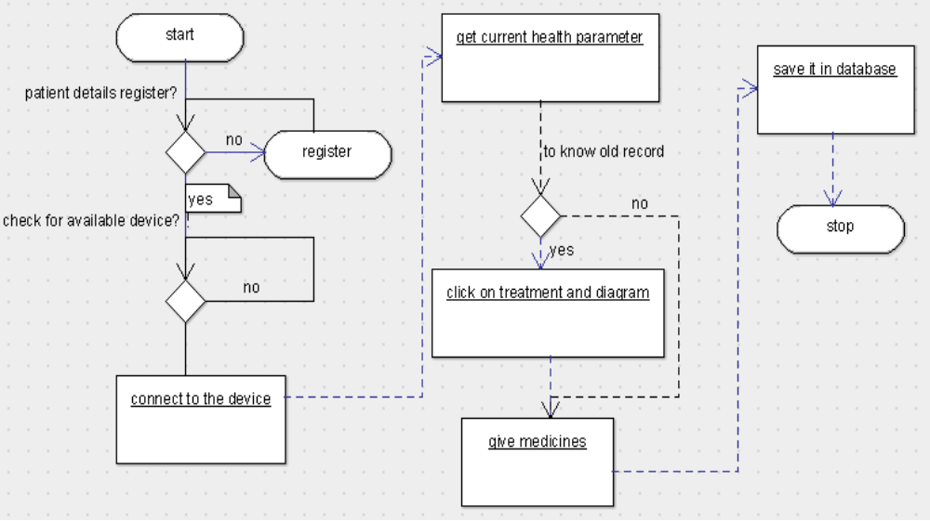
Architecture diagram

Slide 15
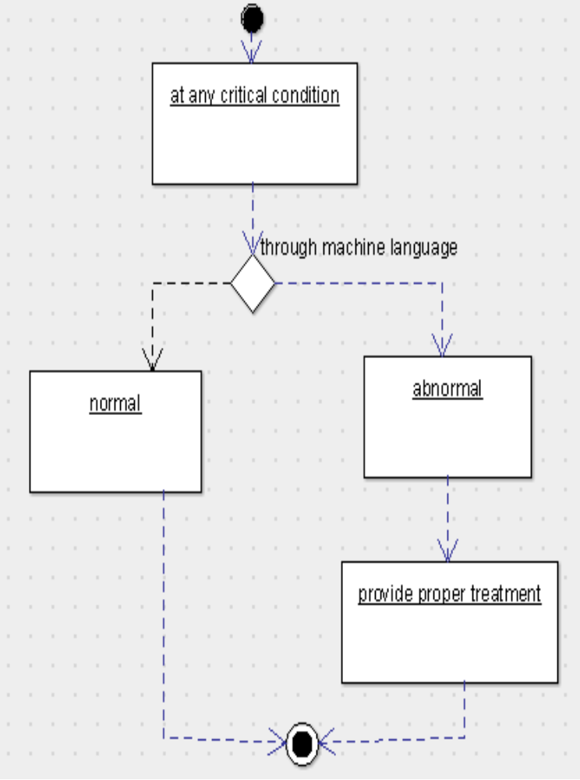

Slide 16
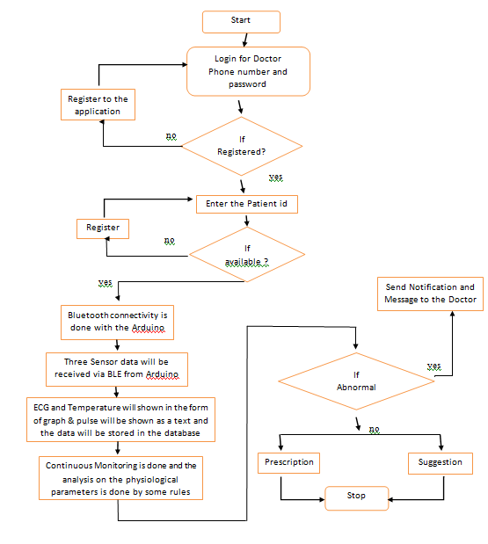
Project work flow

Slide 17
Modules Split up
Arduino
Android

Slide 18
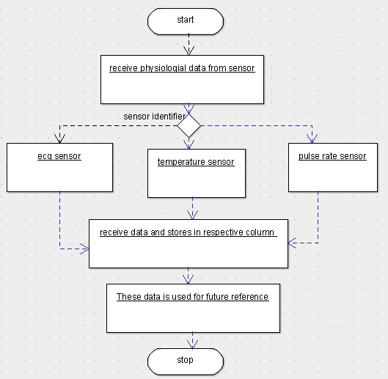
Modules Description(arduino)

Slide 19
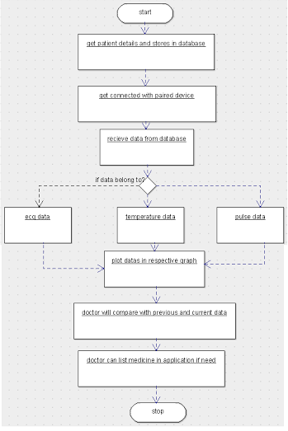
Modules Description(android)

Slide 20
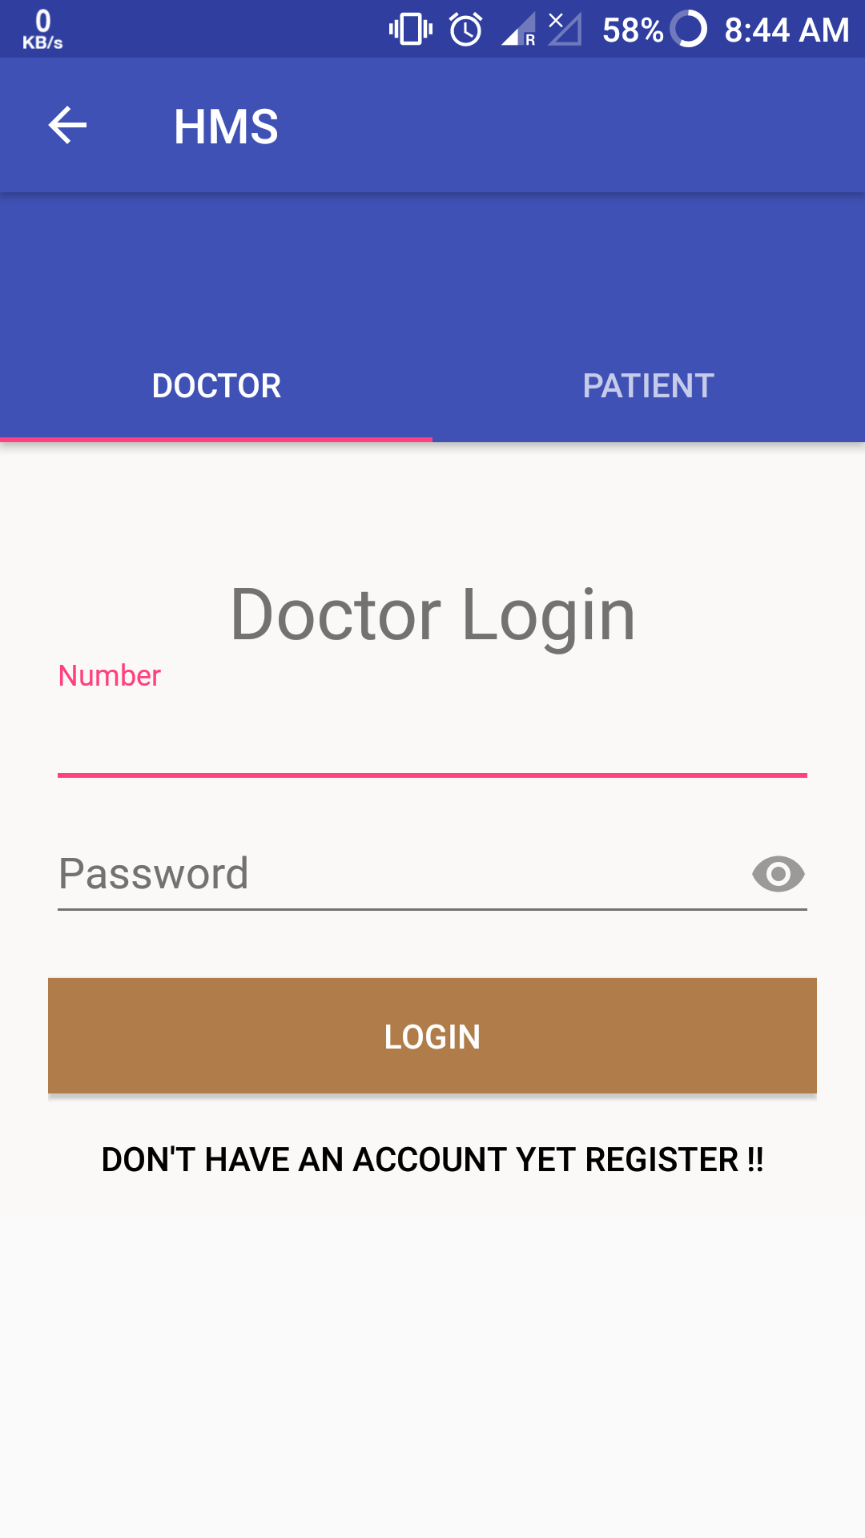
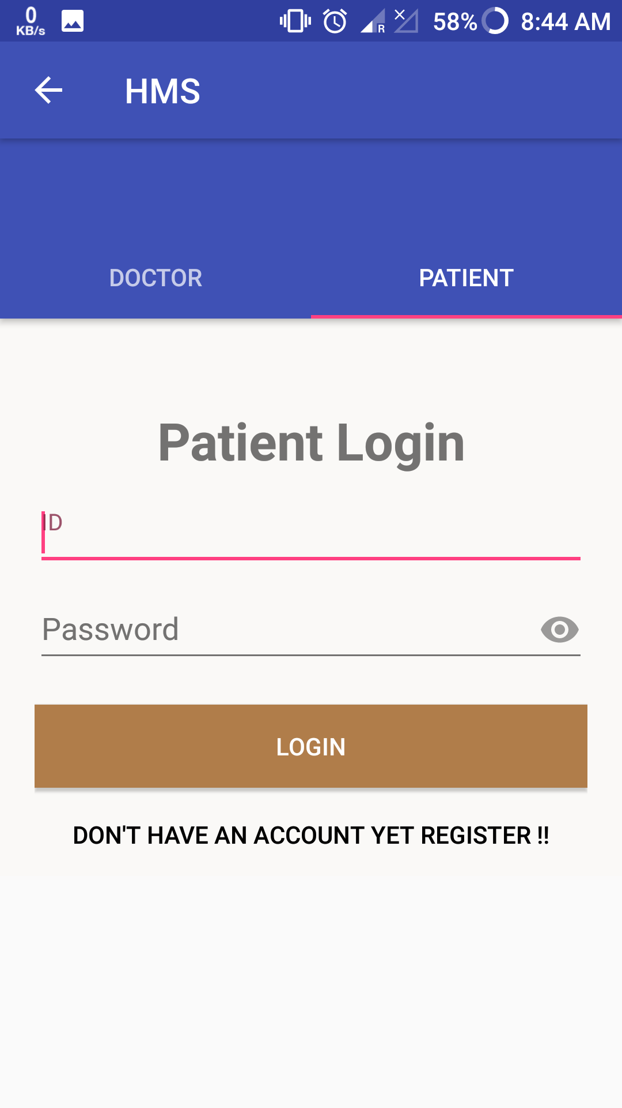
Snapshots
Screenshot for doctor & Patient login

Slide 21
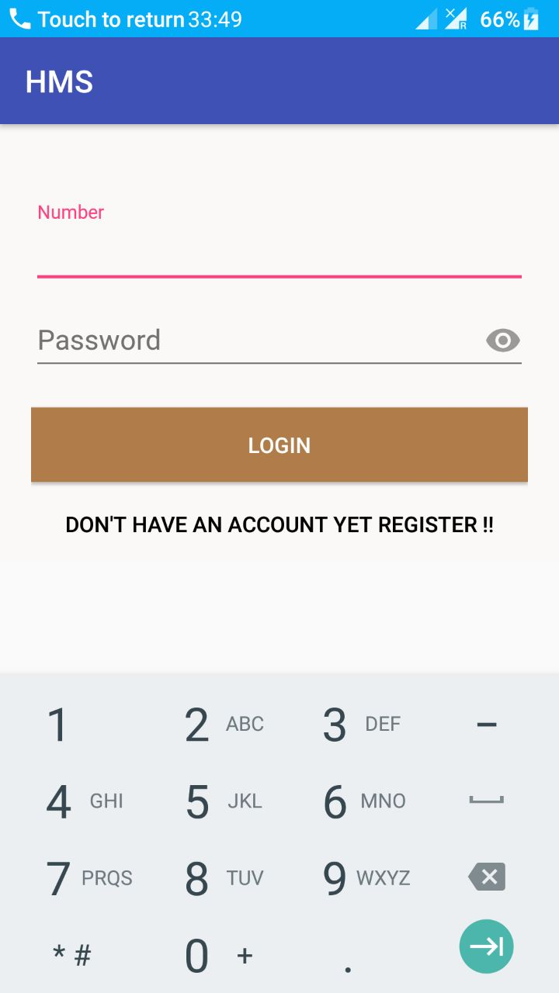
Screenshot for patient id

Slide 22
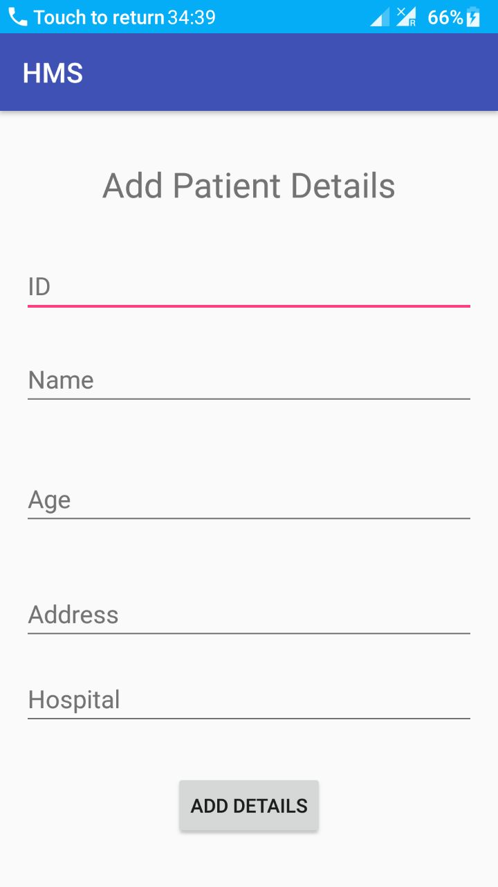
Screenshot for adding new patient details

Slide 23
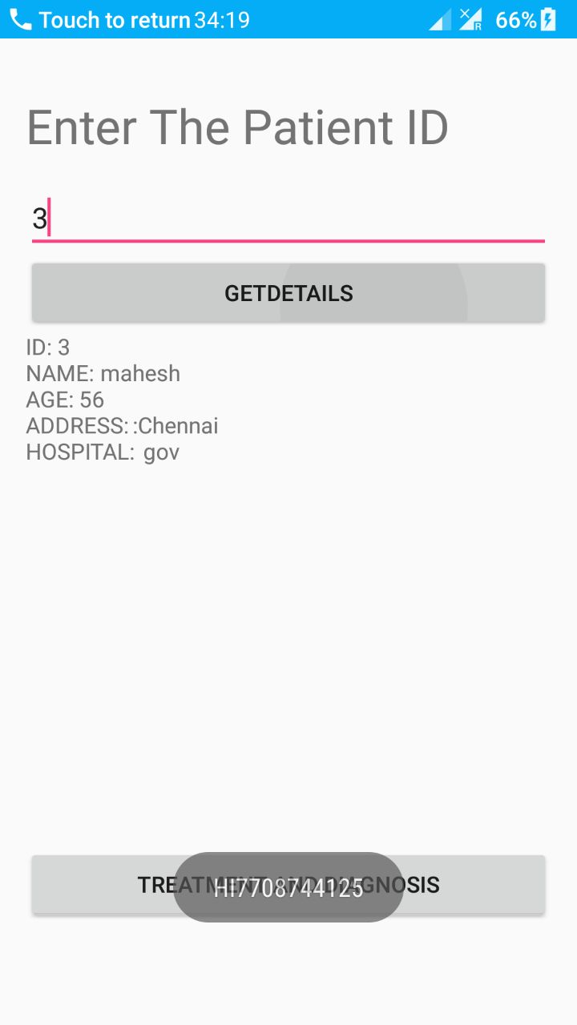
Screenshot of already registered patient

Slide 24
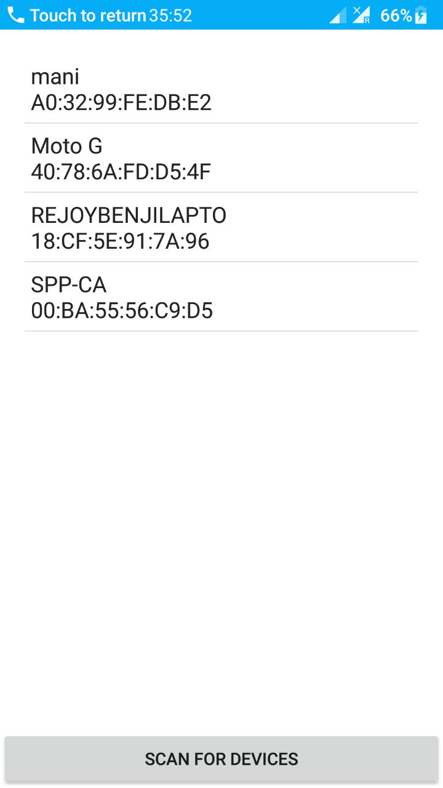
Screenshot for connecting with devices

Slide 25
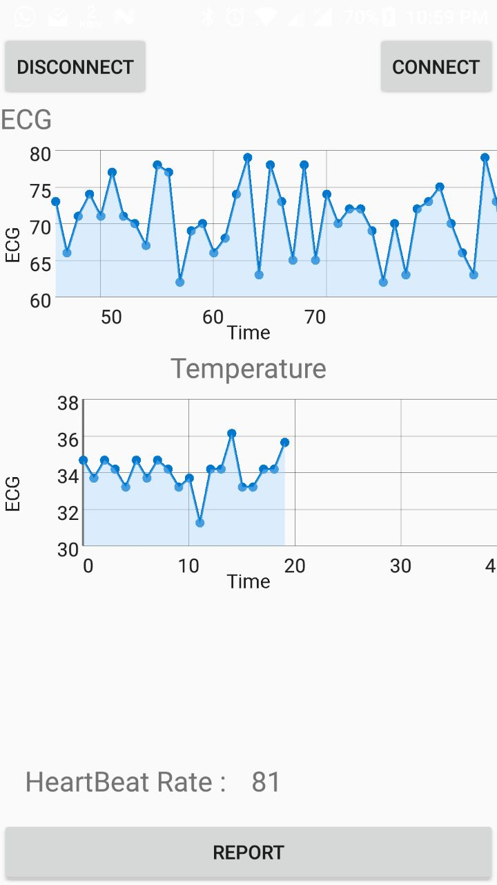
Screenshot of patient health parameter

Slide 26
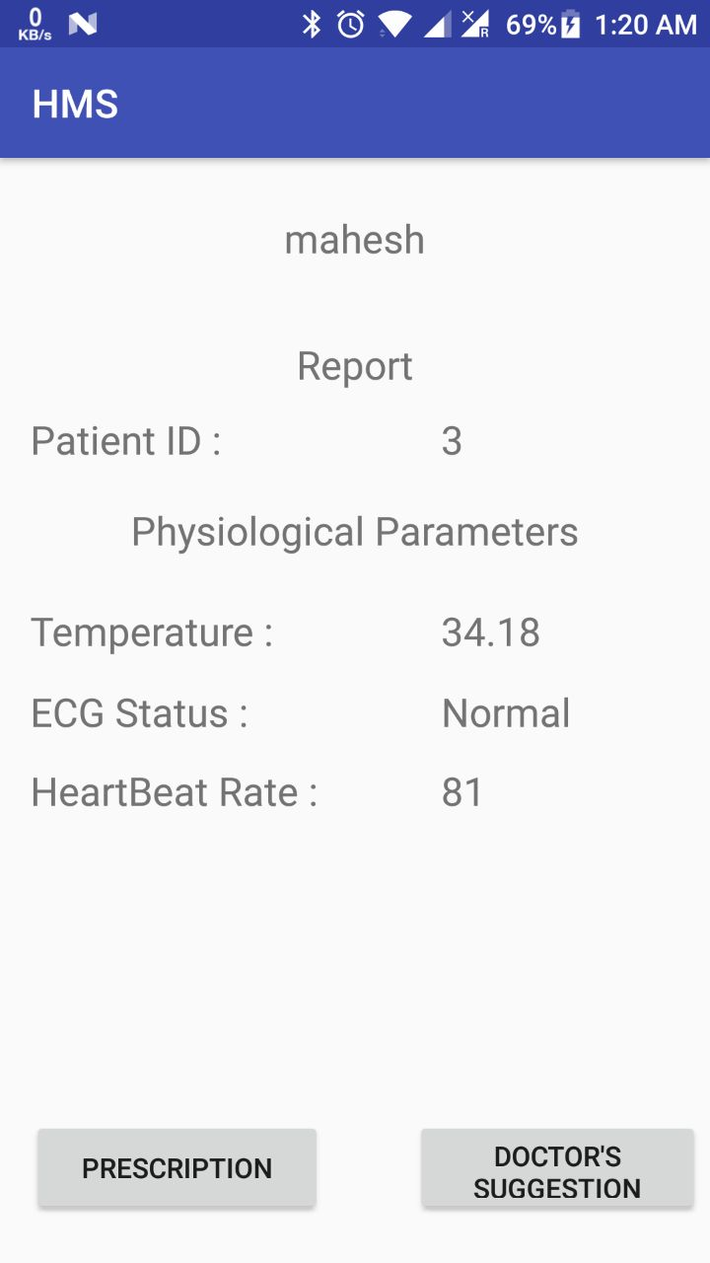
Screenshot for patient report

Slide 27
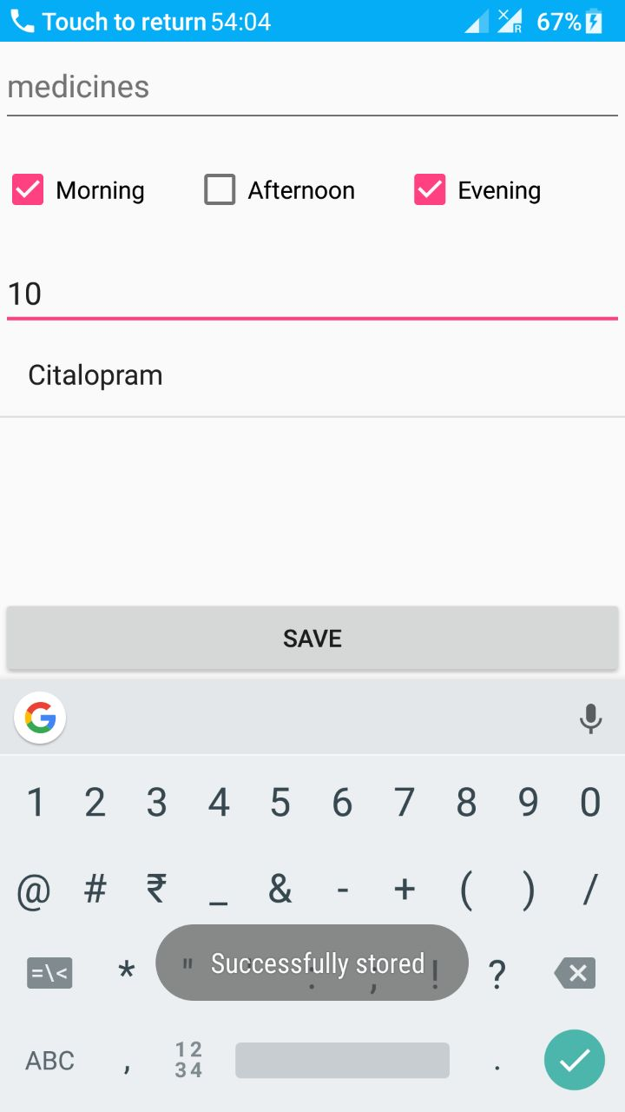
Screenshot for prescription

Slide 28
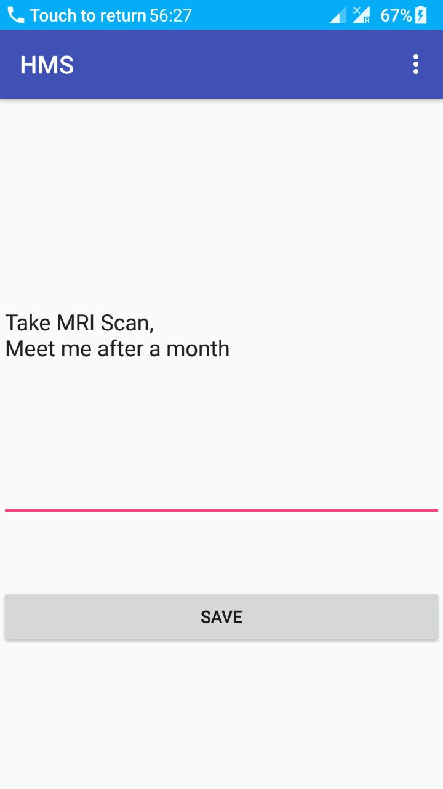
Screenshot for description

Slide 29
Publication details
"Health Care Monitoring System Using Cognitive IOT and WBAN ” has been Registered and Published (IJDRT) for the publication with modification in International Journal of Research and Development in technology (IJRDT) in March 2017, Volume-7,Issue- 3, (MAR -2017) ISSN (O) :- 2349-3585
Publication URL
IJCST Archives : http://ijrdt.org/see_album_all_paper/1053
Publication Permanent URL: http://ijrdt.org/see_album_all_paper/1053/Issue-3-Mar-2017
Current Issue: http://www.ijrdtjournal.org/current-issue.html

Slide 30
References
“A Wireless Health Monitoring System based on Android Operating System” By Dongdong Loua,b, Xianxiang Chena , Zhan Zhaoa , Yundong Xuana,b, Zhihong Xua,b, Huan Jina,b, Xingzu Guo a,b, Zhen Fanga - a Institute of Electronics, Chinese Academy of Sciences, BeiJing,100190,China b University of Chinese Academy of Sciences, BeiJing,100049,China
“The Health Care Monitoring Using Android Mobile Phone” By Pankaja Jadhav , Balaji Devkatta , Vidya Dhumal - Department of Electronics Engineering, Savitribai Phule University of Pune, PDEA’s College Of Engineering, Pune, India
“Real time wireless health monitoring application using mobile devices” By Amna Abdullah, Asma Ismael, Aisha Rashid, Ali Abou-ElNour, and Mohammed Tarique -Department of Electrical Engineering, Ajman University of Science and Technology, P.O. Box 2202, Fujairah, United Arab Emirates
“Android Based Heart Monitoring and Reporting System” By Mayuri Navale ,Sandhya Damare , Rameshwari Chavan , Renuka Dube , Prof. Suhas Patil - Computer Engineering, KJCOEMR, Pune, India
“Performance Evaluation of Healthcare Monitoring System over Heterogeneous Wireless Networks” By Sabato Manfredi Faculty of Engineering, University of Naples Federico II, Napoli, Italy
“Implementation of a Wireless Body Area Network for Healthcare Monitoring” By Aime V. Mbakop, Ashenafi Lambebo , Lalindra Jayatilleke and Sasan Haghani - University of the District of Columbia 4200 Connecticut Ave, Washington, DC, 20008

Slide 31
References
“Wireless Body Area Networks: Applications and Technologies” Rim Negraa , Imen Jemilia , Abdelfettah Belghitha HANAlab, University of Manouba, Tunisia - College of Computer and Information Sciences, King Saud University, Saudi Arabia
“A Survey on Wireless Body Area Network” Emmanuel Davies, Kola Sanjay, J.Mohana - Department of Electronics and Communication Engineering, Saveetha School of Engineering, Saveetha University, Chennai, India
“ECG Auto-analyzing System on Android for 3AHcare Node” Huan Jin, Zhen Fang , Xianxiang Chen , Zhan Zhan , ZhiHong Xu, DongDong Lou, XingZu Guo, Institute of Electronics, Chinese Academy of Sciences, BeiJing, 100190, China

